Slide 1
Team5 Using Public Bicycle
김나현 김송언 박석민 조선민 홍지민

Slide 2
Table of contents
1
4
Objective & exploration
Evaluation
2
Preprocessing
5
Learning Expereience
3
Modeling
Classification
Clustering

Slide 3
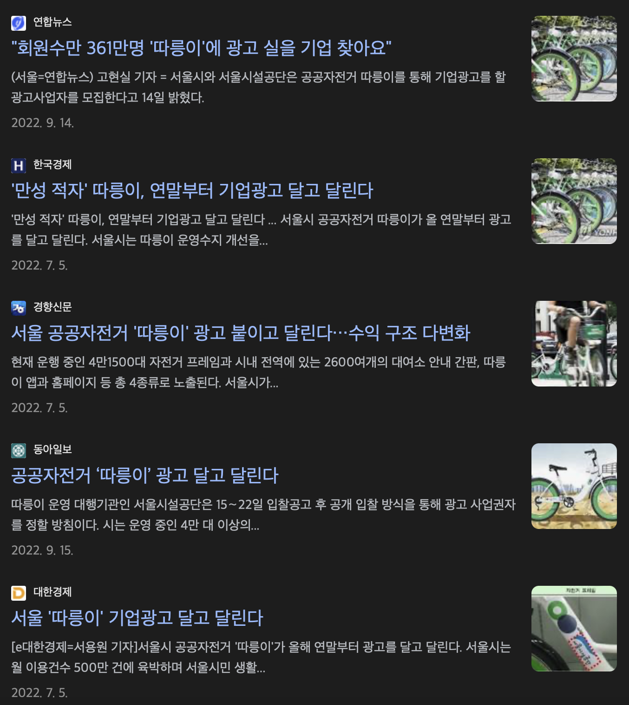
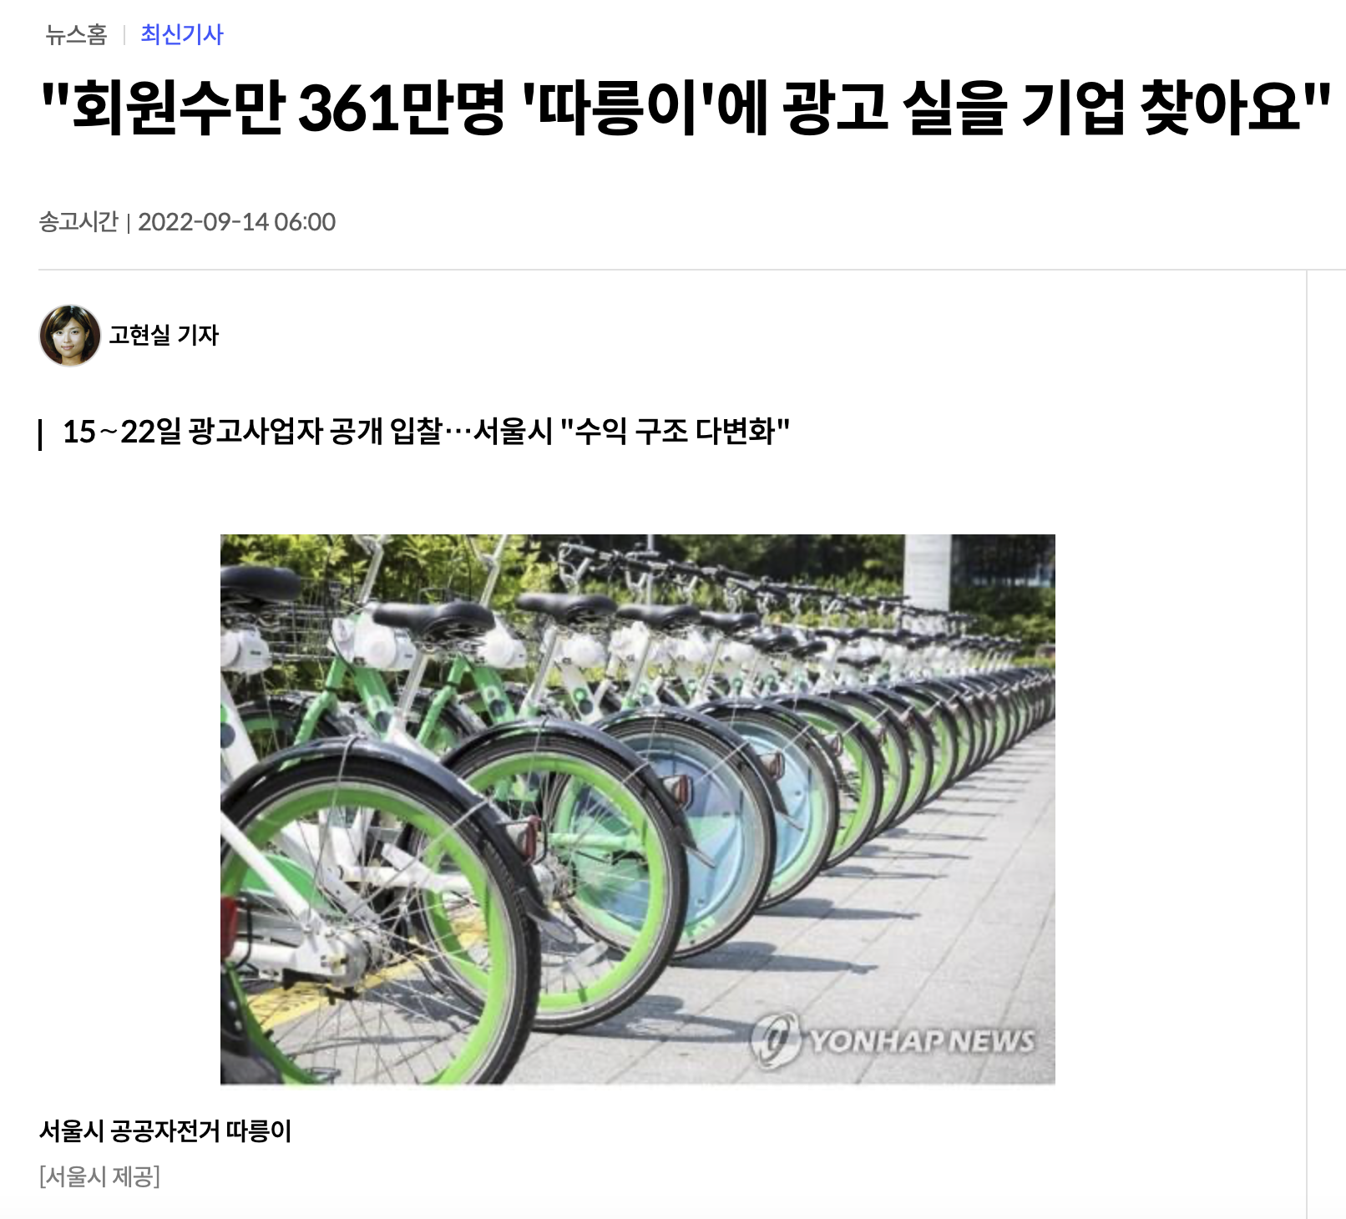
Business objective

Slide 4

Business objective
In which season should,
I advertise to whom It be effective?

Slide 5
Data Exploration

Slide 6



Dataset
Bicycle
Fine dust
Weather
Seoul City Public Bicycle Usage Information
(by Time Slot)
Seoul Metropolitan Area
Hourly Fine Dust Levels
Automated Synoptic Observation System
(ASOS)

Slide 7
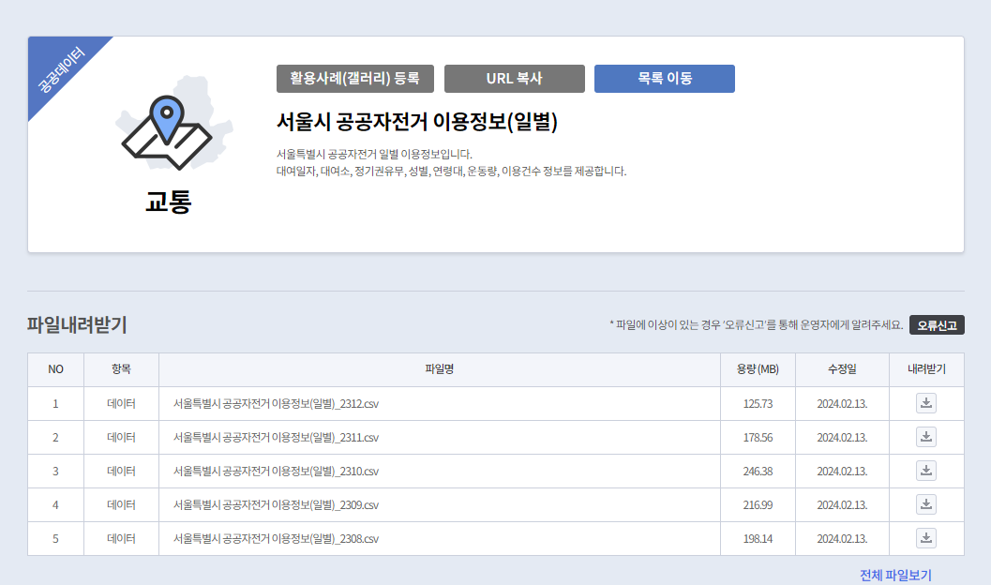
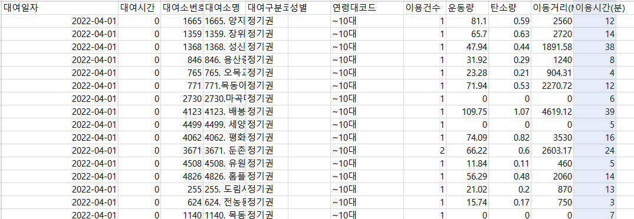
Exploration -
bicycle 2204 (dataset1)
Csv file - Seoul Government Public Bicycle Use Information (Daily)
https://data.seoul.go.kr/dataList/OA-15246/F/1/datasetView.do

Slide 8
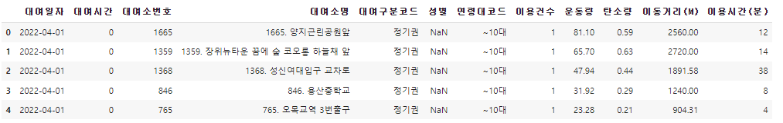
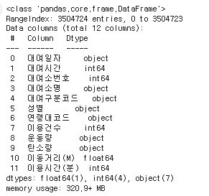
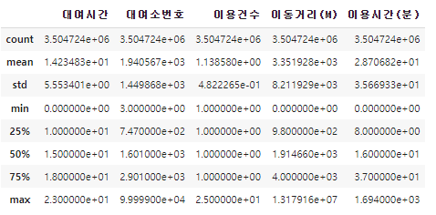
Exploration -
bicycle 2204 (dataset1)
bicycle04.head()
bicycle04.describe()
bicycle04.shape
bicycle04.info()

Slide 9
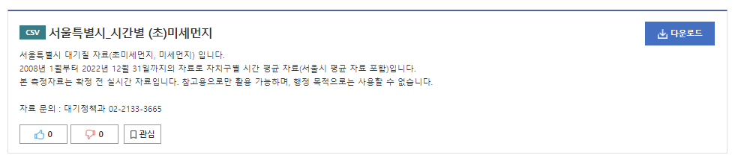
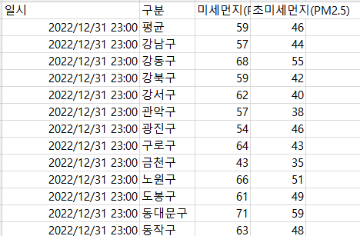
- Air (dataset 2)
Exploration
Csv file - Seoul Government_Time-by-hour (second) fine dust
https://www.data.go.kr/data/15089266/fileData.do

Slide 10
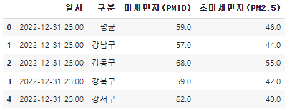
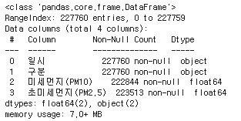
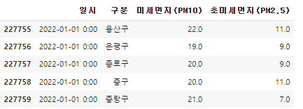
- Air
Exploration
air.head()
air.shape
air.info()
air.tail()

Slide 11
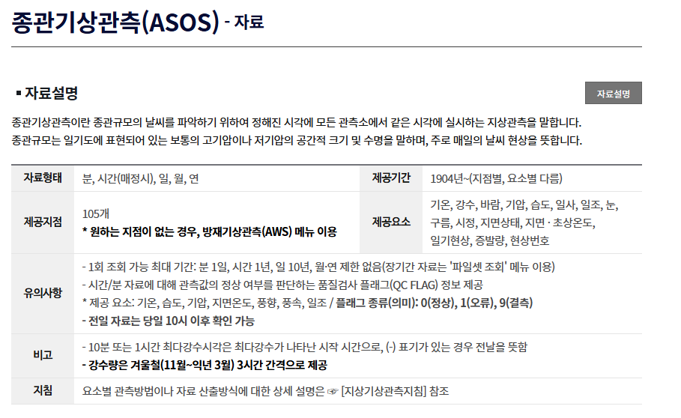
- Weather (dataset 3)
Exploration
Csv file – Korea Meteorological Administration data
https://data.kma.go.kr/data/grnd/selectAsosRltmList.do?pgmNo=36)

Slide 12
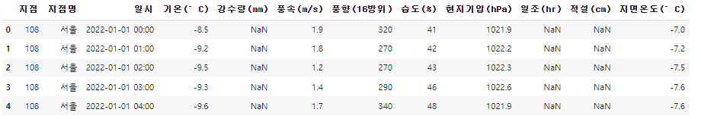
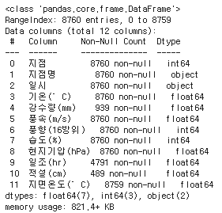
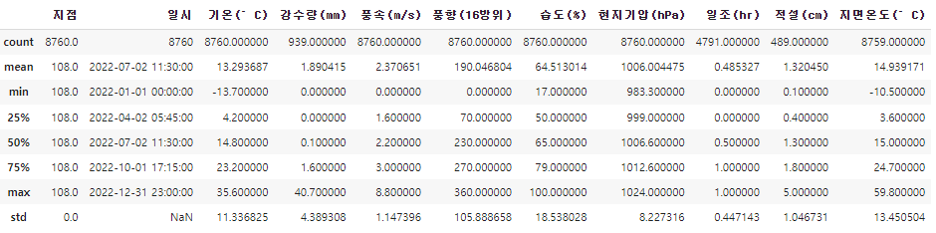
- Weather
Exploration
weather.head()
weather.shape
weather.info()
weather.describe()

Slide 13
Processing AND Merging

Slide 14
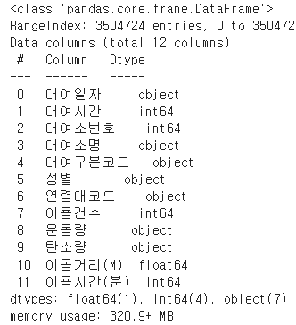
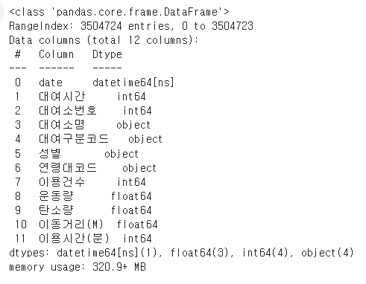
Processing
Convert data – bicycle 2204
- Change type (0bject -> datetime)
- Change Non-numeric
bicycle04["대여일자"] = pd.to_datetime(bicycle04["대여일자"], format='%Y-%m-%d’)
_bicycle04[["탄소량","운동량"]] = _bicycle04[["탄소량","운동량"]].apply(pd.to_numeric, errors='coerce')

Slide 15
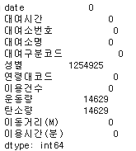
Processing
Missing data – bicycle 2204
- Check missing data
bicycle04_cleaned = _bicycle04.dropna()
* why? : use only gender data , enough data
bicycle04_cleaned.shape
- Missing data drop
_bicycle04.isna().sum()

Slide 16
Processing
- Only meaningful data
- Encoding
# Gender
bicycle04_cleaned['성별'] = bicycle04_cleaned['성별'].map({'F': 0, 'M': 1})
#Age
bicycle04_cleaned['연령대코드'] = bicycle04_cleaned['연령대코드'].map({'~10대':10, '20대': 20, '30대': 30, '40대': 40, '50대': 50, '60대': 60, '70대이상': 70})
# Ride a bike < 10 → consider not ride
bicycle04_cleaned = bicycle04_cleaned[bicycle04_cleaned["이용시간(분)"] >= 10 ]
- Unused feature → drop
bicycle04_cleaned = bicycle04_cleaned.drop(columns=["대여소번호", "대여소명", "대여구분코드"])

Slide 17
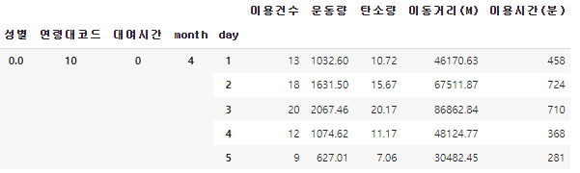
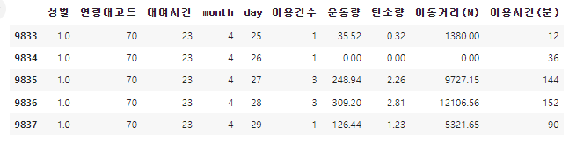
Processing
After date data split by month and day → Grouping
bicycle04_grouped_sum = bicycle04_cleaned.groupby([bicycle04_cleaned["성별"],bicycle04_cleaned["연령대코드"],bicycle04_cleaned["대여시간"],bicycle04_cleaned["month"],bicycle04_cleaned["day"]]).sum()
bicycle04_grouped_sum.head()
bicycle04_grouped_sum.tail()

Slide 18
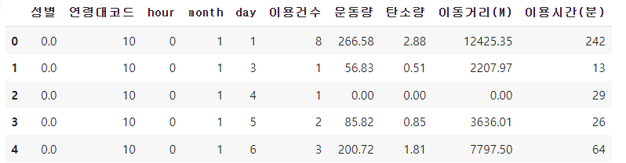
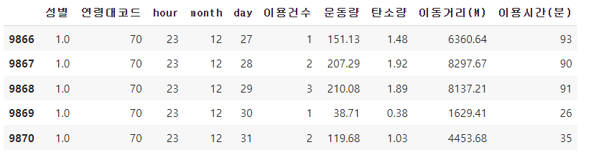
Processing
Apply the April data preprocessing to all monthly data -> combine into One Data
combined_bicycle = pd.concat(bicycle_list, ignore_index=False)
combined_bicycle.head()
Result (Dataset 1)

Slide 19
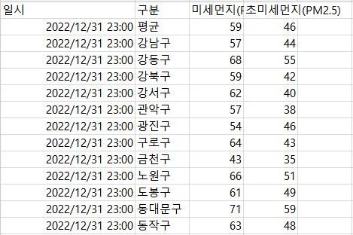
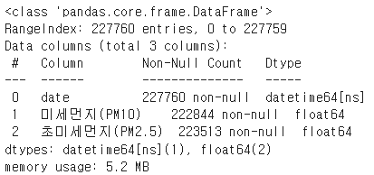
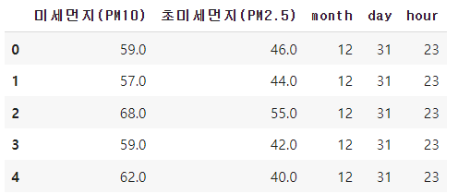
Processing
Convert data – Air
- Unused feature → drop
& split month, day, hour
air = air.drop(columns="구분")
- Change type
air["일시"] = air["일시"].astype("str")
air["일시"] = pd.to_datetime(air["일시"])
air.rename(columns={"일시":"date"}, inplace=True)

Slide 20
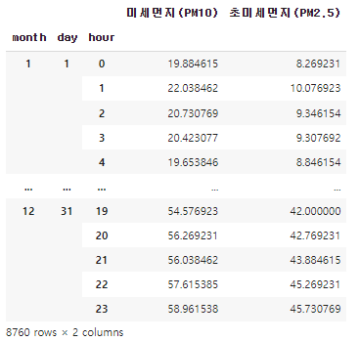
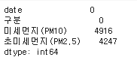
Processing
Missing data – Air
- Mean
- Check missing data
air = air.groupby([air["month"],air["day"],air["hour"]]).mean()
air.isna().sum()
Result (Dataset 2)

Slide 21
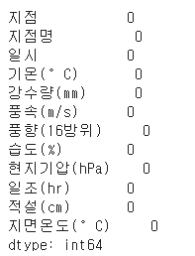
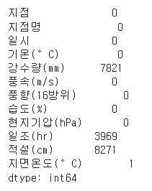
Data Processing
Missing data – Weather
- Convert data
- Fill the data
weather["일시"] = pd.to_datetime(weather["일시"])
weather["지면온도(°C)"].fillna(method='ffill', inplace=True)
- Check missing data
weather.fillna(0,inplace=True)
weather.isna().sum()

Slide 22
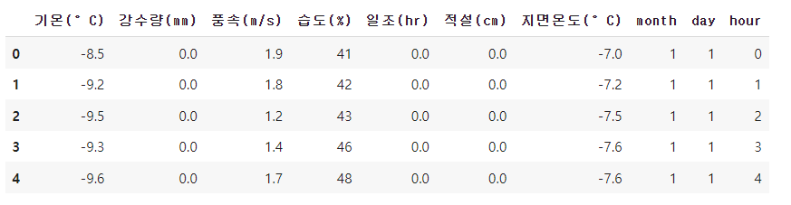
Data Processing – Weather
- Unused feature
weather.drop(columns=["지점","지점명","풍향(16방위)","현지기압(hPa)"], inplace=True)
- Split month, day, hour
weather["month"] = weather["date"].dt.month
weather["day"] = weather["date"].dt.day
weather["hour"] = weather["date"].dt.hour
Result (Dataset3)

Slide 23
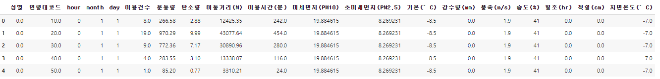
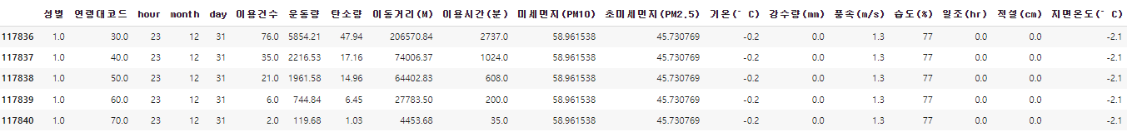
Make Final Data (Merging 3 datasets)
df = pd.merge(combined_bicycle, pd.merge(air, weather, on=['month','day','hour'], how='outer'), on=['month','day','hour'], how='outer')

Slide 24
Modeling
# Decision Tree #Clustering #Linear Regression #Logistic Regression #Poly Regression

Slide 25
Classification Decision Tree

Slide 26
Preprocessing Decision Tree
‘미세먼지’
0 : <31
1 : 31<= df[‘미세먼지(PM10)’] < 81
2 : 81<= df[‘미세먼지(PM10)’] < 151
3 : 151<= df[‘미세먼지(PM10)’]
Good
normal
bad
Very bad
Code
df.loc[(df['미세먼지(PM10)'] > 30) & (df['미세먼지(PM10)'] < 81), '미세먼지(PM10)'] = 1
df['미세먼지(PM10)'] = df['미세먼지(PM10)'].astype(int)

Slide 27
Preprocessing Decision Tree
‘초미세먼지’
Good
0 : <16
1 : 16<= df[‘미세먼지(PM10)’] < 36
2 : 36<= df[‘미세먼지(PM10)’] < 76
3 : 76<= df[‘미세먼지(PM10)’]
normal
bad
Very bad
‘이동거리’
‘기온’
0 : < 25
1 : 25<= df[‘미세먼지(PM10)’] < 50
2 : 50<= df[‘미세먼지(PM10)’] < 75
0 : < 0 ( winter )
1 : 0 ~ 19 ( spring )
2 : 20 ~ ( summer )
Notes:
그 외에도 지면온도, 풍속 , 강수량 , 적설 (많아서 다 적지는 않음)

Slide 28
Preprocessing Decision Tree
- It also changes the ground temperature, wind speed, precipitation, and snow standards
Convert integer type (Gender, age code, distance)
Specify x, y
X = df[['성별', '연령대코드', 'hour', 'month', 'day', '미세먼지(PM10)', '초미세먼지(PM2.5)', '기온(°C)', '강수량(mm)','풍속(m/s)','습도(%)', '적설(cm)', '지면온도(°C)']]
y = df["이동거리(M)"].astype(int)

Slide 29
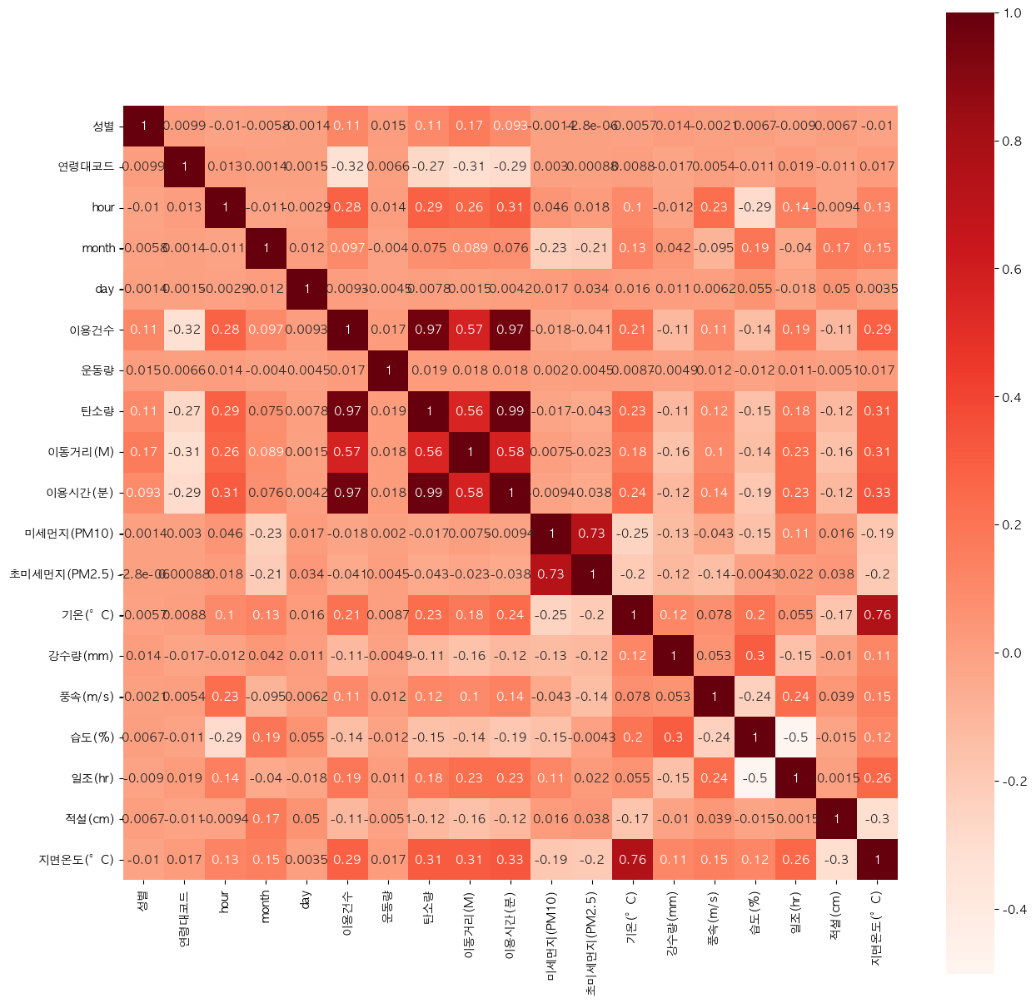
Preprocessing Feature Selection Decision Tree
df.drop(columns={"이용건수","운동량","탄소량", "이용시간(분)"})
# Strong Relationship with Travel Distance
df.drop(columns={"지면온도(°C)"})
# Significant Relationship with Temperature

Slide 30
Final Data Classification _ Decision Tree
Train model & Make predictions
X_train, X_test, y_train, y_test = train_test_split(X, y, test_size=0.2, random_state=42)
tree_model = DecisionTreeClassifier(random_state=100, max_depth=10)
tree_model.fit(X_train, y_train)
y_pred = tree_model.predict(X_test)

Slide 31
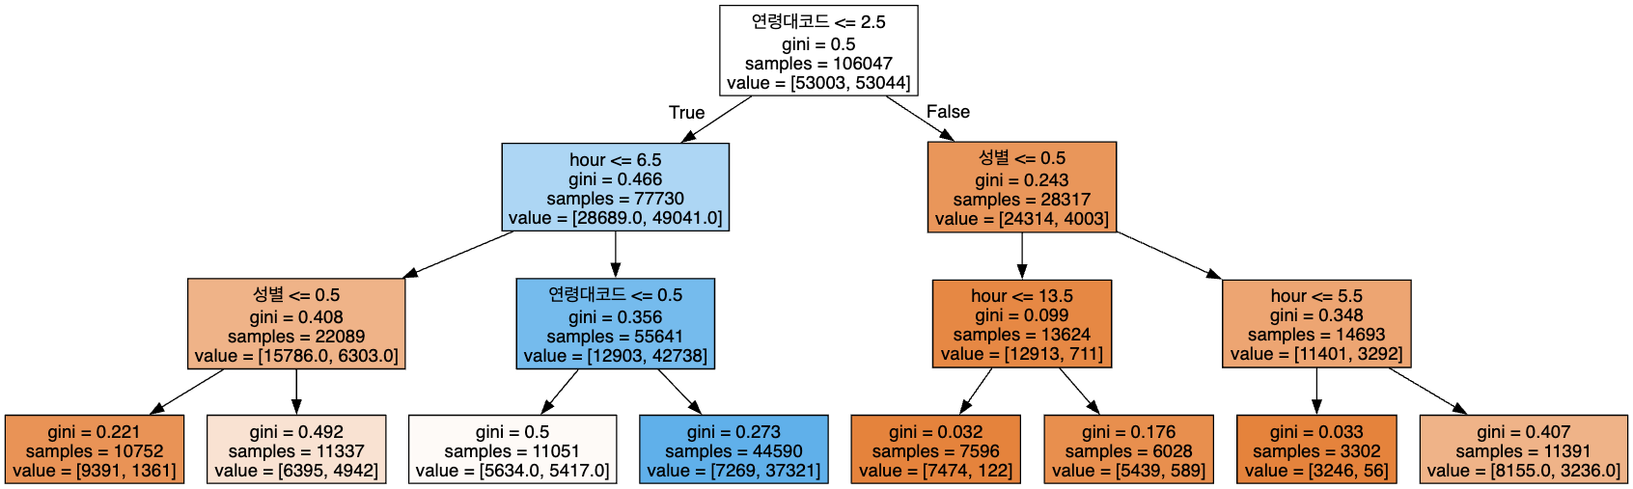
Final Data Classification _ Decision Tree
# It is NOT our actual result
# Accuracy: 0.8793, Precision: 0.8799, Recall: 0.8793

Slide 32
Evaluation Decision Tree
# Define the parameter grid to search
param_grid = {
'max_depth': [None, 10, 20, 30],
'min_samples_split': [2, 5, 10],
'min_samples_leaf': [1, 2, 4]
}
# Create a GridSearchCV object
grid_search = GridSearchCV(tree_classifier, param_grid, cv=5)
# Best hyperparameters: {'max_depth': 20, 'min_samples_leaf': 4, 'min_samples_split': 10}
# Test set accuracy: 0.8649093904448105

Slide 33
Evaluation Decision Tree
kf = KFold(n_splits=5, shuffle=True, random_state=42)
cv_scores = cross_val_score(tree_model, X_test, y_test, cv=kf, scoring='f1_macro')
print(f"K-Fold Cross-Validation F1 Scores: {cv_scores}")
print(f"Mean F1 Score: {np.mean(cv_scores)}")
print(f"Standard Deviation of F1 Scores: {np.std(cv_scores)}")
# K-Fold F1 Scores: [0.85192775 0.86795525 0.86800661 0.85489818 0.85993168]
# Mean F1 Score: 0.8605438970632937
# SD of F1 Scores: 0.006589493558245855

Slide 34
Conclusion.
- Predict
“Companies make predictions by,
putting the data they want into the model.”
- Easy interpretation
“Following the tree,
we analyze data based on conditions,
unearth valuable insights from it.”

Slide 35
Other Models
Linear Regression
Logistic Regression
- Preprocessing
Class imbalances were handled and features were standardized.
- Model Training
The model was trained on the processed dataset.
- Model Evaluation
The model was evaluated using accuracy, precision, recall, and F1 score.
- Result
We tried combining various features and changing their order as it didn't fit our data, but training failed.
- Preprocessing
Scaled dataset and generated polynomial features.
- Model Training
Trained on processed features.
- Model Evaluation
Evaluated using MSE and R².
- Result
Performance affected by overfitting and potential removal of important features.

Slide 36
Conclusion.
- Decision Tree
Handles non-linear relationships well but requires careful tuning.
- Logistic Regression
Simple and interpretable, suitable for binary classification but less effective with complex data.
- Linear Regression
Good for continuous targets but needs extensive feature engineering.

Slide 37
Learned doing the project
M
D
M
S
Memory
Model
"Machine learning requires significant resources."
"Selecting a model that suits the purpose and data."
Data
Selection
“Choosing and find
the data”
"Selecting appropriate features."

Slide 38
Learned doing the project
- Iterate over every column
- Determine if the column is numeric
- Determine if the column can be represented by an integer
- Find the min and the max value
- Determine and apply the smallest datatype that can fit the range of values
# Memory usage of dataframe is 11.69 MB
# Memory usage became: 1.4609670639038086 MB

Slide 39
Thank You

